Slide 1
Comparative Efficiency Analysis between USB PD and PPS for Fast Charging
Fahad Ahammad
Engineer, Central Applications

Slide 2
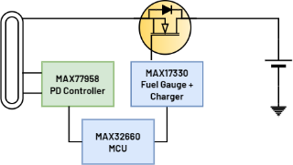
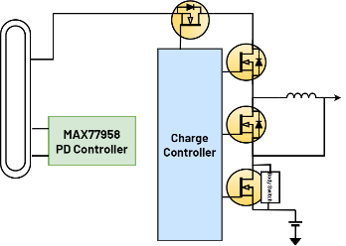
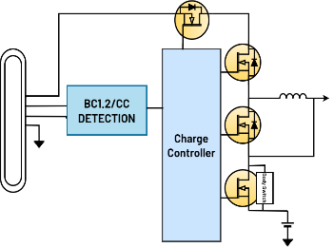
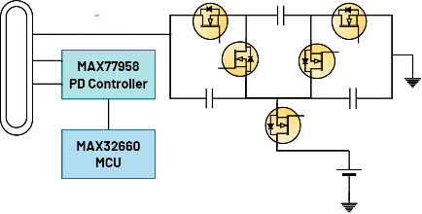
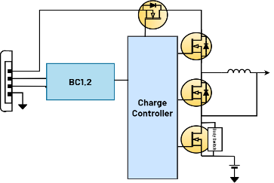
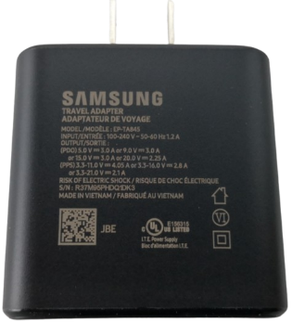
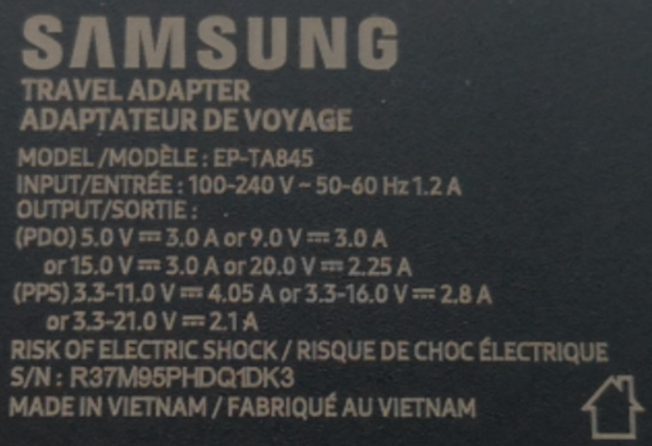
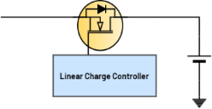
Standardization of Charging
3.3 – 4.2V
Up to 5A
3.3V
5-20VIN
MAX77986
Up to 5A
Direct Charger
(PPS Compliant)
5V/9V
MAX77787
LTC7825
3A
6.6 – 8.4V
Up to 5A
MAX77840
Switching charger (Wide VIN)
PD Compliant
5V
1.5A
MAX77986
Switching charger (added CC
detection)
Switched Capacitor Converter
(PD/PPS Compliant)
500mA
1.5A
5V
Switching charger (BC1.2)
Linear Charger
Notes:
3 elements in given USB PD charging circuit: Source, Sink, Cable and connector
What is the need for USB Type C PD Charging? Ans: Standardization: More Devices are adopting Type C for charging. The power/voltage range of this device varies from 5V-20V (25W – 100W (5A)). Eg: A Bluetooth Speaker can be an eg for lower power requirement while a typical Laptop can be taking 60W (20V, 3A) of power.
The solution is using a Power Delivery Feature of a power adapter. Basically, we can use the same adapter to charge both devices of different power requirement.
Limitation of USB PD for fast charging – Example single cell application with charging current of 3A, Using of Switching converter -> Low efficiency of
Why PPS? Under PD 3.0, we have additional specification called PPS. Programmable Power Supply where we can change the voltage in small steps of 20mV from 3.3V-20V.
Why do we need PPS? Have you wondered how the modern smart phones is charging quickly without much heating? Smart phones -> Larger Batteries -> Higher Charging current -> Complex Charging method to gain higher efficiency for higher current? Suppose for a single cell application

Slide 3
Agenda
USB C Fundamentals
USB Power & Data Role
Typical Fast Charging Solution
Type C Adapter Detection
USB PD Charging
USB PD negotiation sequence (Standalone Mode)
MAX77958 PD Negotiation Commands
Using additional MCU
Dynamic Voltage Negotiation to improve Efficiency
Direct Charging
Solve Heating crisis
MAX77958 PPS Commands & Introduction to charging S/M
Efficiency Analysis
How to Find Opportunities?
Efficiency Analysis
Notes:
For today’s agenda, we will start with USB C Fundamentals understanding of various roles that a device can take, How a typical USB Type C fast charging solution looks like and how our ICs fit into those solutions, then we will briefly discuss on how the sink understands the source current capability upon connection
Then we will move to USB PD charging
In the USB PD Charging section, we will discuss on how a a sink negotiates with a source for different PD profiles, commands for doing the same, and role of an additional MCU for doing Dynamic Voltage Negotiation and how it can increase the efficiency.
But For higher charging currents, the PD charging solution will heat up, which leads to the discussion of what is direct charging, and how it helps to reduce the heating for the same charging current as before.
Then we do an efficiency analysis between the two solutions and establish the difference!

Slide 4
USB C Fundamentals
Notes:
Let’s go through the USB C fundamentals briefly

Slide 5

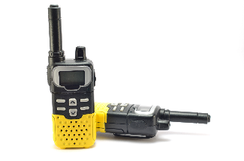

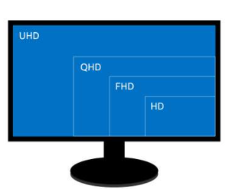

USB Data & Power Flow
Power Roles
Data Roles
Source
Sink
DRP
DFP
UFP
DRD
Provides power on Vbus.
E.g. Wall charger
Dual Role Port
Downstream Facing Port
Upstream Facing Port
Dual Role Data
Consumes power from Vbus.
E.g. USB keyboard
Can operate as Source & Sink.
E.g. Laptop Port
Consumes data from DFP.
E.g. Display monitor port
Can operate as DFP or UFP.
E.g. Laptop Port
Sends data downstream.
E.g. port on a Host or hub
Notes:
In a typical charging application, a device can take different roles.
When it comes to power, there are three categories: Source capable of providing power e.g. Adapter, sink which takes the power say a camera and we have something called Dual Role Port
Which can provide as well as take like in the case of a power bank.
There are another three categories for data namely DFP (Downstream Facing Port) capable of sending data say a PD adapter sending its source capabilities to the device connected, UFP (Upstream Facing Port) capable of receiving data e.g. monitor receiving data from laptop for screensharing and finally DRD (Dual Role Device) say a laptop which is capable of both sending and receiving data

Slide 6
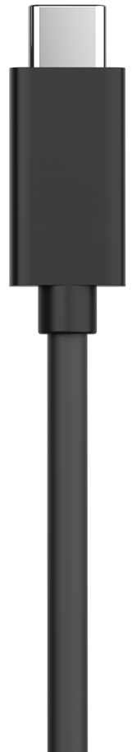

Typical Fast Charging Solution
VSUPPLY
Source Side (Fast Charging capable)
Sink side (Fast Charging capable)
BUCK-BOOST H-BRIDGE FETs
LOAD SWITCH/S.C.C.
VBUS
VDD
PD CONTROLLER WITH PPS SUPPORT
VBUS
CC1
CC1
PD CONTROLLER
WITH PPS SUPPORT
CHARGER
CC2
CC2
I2C
I2C
MCU
MCU
FUEL GAUGE
I2C
Notes:
Now, lets see understand how a typical fast charging solution looks like:
The source mainly consists of a PD controller having PPS capability which in combination with an internal or external buck boost controller to provide different voltage levels at VBUS based on the request from the sink. The VSUPPLY can be either from a car battery for automotive applications or from a flyback for consumer applications
Some PD controller requires a microcontroller and others can work standalone.
The Sink will have a PD controller which is again PPS capable and can work on standalone as well as used along with a microcontroller. A charger whose topology can be buck, boost or buck-boost based on the cell configuration, a fuel gauge for monitoring the battery parameters and finally a load switch or SCC.
Suppose, if a power adapter is PPS capable, then the sink switches to Fast charging using the LSW/SCC otherwise the sink goes to PD charging using the charger.

Slide 7
Feature Comparison: MAX77958 vs. MAX25432B in PD and PPS Applications
Role | MAX77958 | MAX25432B
Sink PD capable | Y | N
Sink PPS capable | Y | N
Source PD capable | Y | Y
Source PPS capable | N | Y
DRP | Y | N
Automotive | N | Y
Standalone Operation | Y | N
Automotive dashboard charging
Charging stations
MAX25432B
Conference USB hubs
Dedicated Charging modules
PD adapter
Portable monitors
Mobile Phones
Gaming consoles
Power Banks
MAX77958
Camera Charging
VR Headset
Normal/Gaming Laptops
Tablets
Notes:
In our Portfolio, we primarily have two ICs for PD controllers.
One is MAX77958, which can be used in both source and sink side. But when it comes to source side, it is only PD capable and not PPS.
The Other one is MAX25432 which can only be used in the source side but unlike MAX77958 it is capable of PPS.
MAX25432 is an automotive grade IC used for automotive applications while MAX77958 is primarily meant for consumer applications.
MAX25432 especially the B version, needs a micro to do a part of the software but MAX77958 can be operated in standalone as well as with a MCU for more flexibility.
MAX77958 is meant for applications like PD adapter working in source mode, then for Power bank while configured for DRP mode and for charging consumer appliances like Camera, VR headset and so on.
MAX25432 in the other case can be used for applications like automotive dashboard charging, Conference Hubs, Dedicated Charging modules and so on….

Slide 8
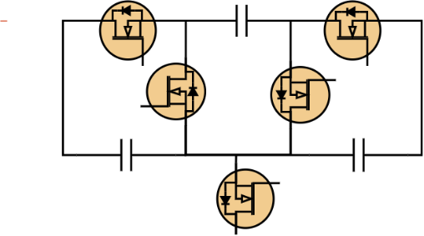
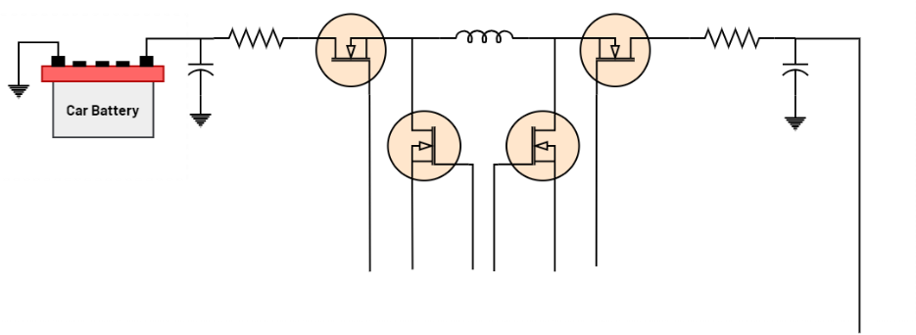



Fast Charging Block Diagram
$${\text{C}}_{\text{FLY}}$$
$${\text{C}}_{\text{HIGH}}$$
$${\text{C}}_{\text{LOW}}$$
LTC7825
(S.C.C.)
RUN
2:1
VBUS
MAX25432
TCPC
VBUS
CC1
CC1
MAX77958
PD negotiator
MAX77986
Buck Charger
CC2
CC2
I2C M
I2C
ALERT
I2C S
POWER
I2C
I2C
MAX32660
TCPM
MAX32660
MCU
MAX17260/2
Fuel Gauge
I2C
Source Side (Fast Charging capable)
Sink Side (Fast Charging capable)
Notes:
Now let’s see, how our ICs fits into the solution.
In source side, we can use MAX25432 basically a Type C Port Controller (TCPC) which is capable of doing both PD and PPS and has an integrated buck boost controller.
The TCPC has to be managed by a TCPM which stands for Type C port Manager, in this case a microcontroller MAX32660.
This combination is capable of providing fixed voltages such as 5, 9, 15, 20V for PD charging and 3.3 – 21V in steps of 20mV to support PPS charging.
In Sink side, considering a single cell charging topology, MAX77958 is used as PD controller along with MAX77986 buck charger to implement PD charging.
For Fast Charging, an MCU is utilized along with MAX77958, LTC7825 switched capacitor and a single cell Fuel Gauge for monitoring battery parameters for developing the charging state machine

Slide 9
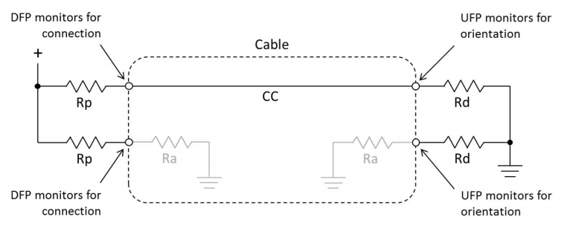
Type C Adapter Detection
Source current advertisement with Rp
Sink side monitoring for current advertisement
Source Current Capability | Current Source | Rp to 4.75V to 5.5V | Rp to 3.3V
Default 500mA/900mA | 80uA | 56KΩ | 36KΩ
1.5A | 180uA | 22KΩ | 12KΩ
3.0A | 330uA | 10KΩ | 4.7KΩ
Source Current Advertisement | Min voltage | Max voltage
Default 500mA/900mA | 0.25V | 0.61V
1.5A | 0.7 | 1.16V
3.0A | 1.31 | 2.04V
Notes:
Before moving to USB PD Charging, we need to understand how a basic communication happens between a source and sink.
Let us take the example of how a sink walkie talkie in this case reads the source current capabilities and initiates standard 5V charging.
The adapter mainly consists of a pull up resistance Rp which is designed by the manufacturer based on its current capabilities.
The sink on the other hand will have a pull resistance Rd.
Upon connection, either of the CC pins, CC1 or CC2 will be active at a time and complete the resistor divider.
The CC detection chip inside the sink, will monitor the voltage at the cc pin and configure the input current limit of the charger IC inside it and enables it.
This completes the standard 5V charging.

Slide 10
USB PD Charging

Slide 11

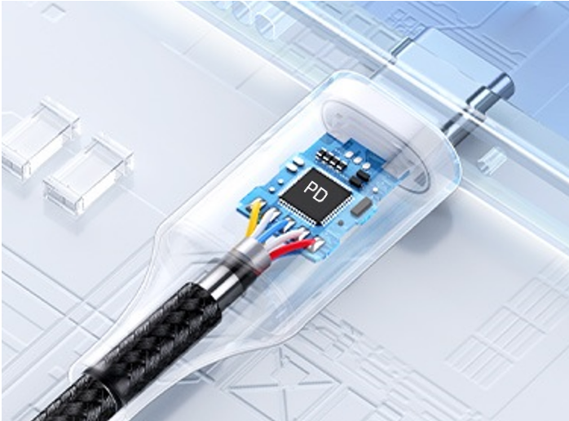
What is USB Power Delivery?
60W
100W
VBUS
20V
CC pins
15V
VBUS
Source
Sink
9V
5V
3A
5A (E-Marked Cables)
Inside of an e-marked cable
CURRENT LEVEL
Notes:
As we know different sinks will support different voltage levels but comes with standard type c connector.
One of the advantage of Power Delivery is that a single PD adapter can be used for charging different sink devices like 5V for Headphones, 9V for Power banks, 15V for some Cameras and 20V for laptops
The current in this case can go up to 3A in normal cables and 5A by utilizing E-Marked or Electronically Marked Cables which I have a depicted in the picture given.
The adapter basically understands the sink voltage level requirement by CC pin communication.

Slide 12
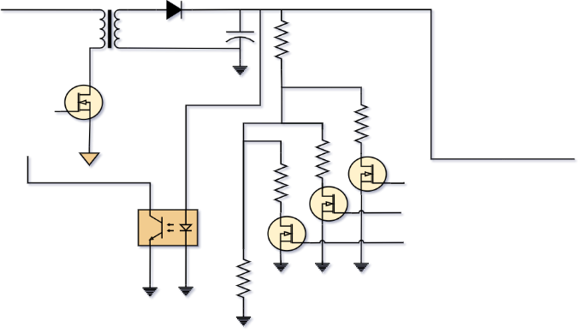



Typical USB PD Negotiation Sequence
Flyback Controller
VBUS
Sink side
MAX77958
PD negotiator
MAX77986
Buck Charger
MAX77958
PD negotiator
CC1
I2C M
I2C
CC2
I2C S
Rp
SOURCE
CC1
Ra
Rd
SINK
Rp
CC2
TYPE C ADAPTER DETECTION
CC1=${\text{V}}_{\text{Ra}}$
CC2= ${\text{V}}_{\text{Open}}$
Plug-In
Rd
(CC2 Active)
CC1= ${\text{V}}_{\text{Ra}}$
CC2= ${\text{V}}_{\text{Rd}}$
5V
VBUS=5V
0V
VCONN=On
Slow Charging
SRC_CAP: Source capabilities message
5V/3A FIXED PDO
9V/3A FIXED PDO
12V/3A FIXED PDO
20V/3A FIXED PDO
USB PD NEGOTIATION
SRC_CAP
How do we Set Sink PDOs?
REQUEST
ACCEPT
9V
SINK PDOs stored in MAX77958
5V/3A FIXED PDO
9V/3A FIXED PDO
VBUS=9V
5V
PS_RDY
PD Charging
Notes:
Now, lets see how an adapter negotiates different VBUS voltage levels based on the sink requirement.
For that, in source side, I have used MAX77958 in standalone mode whose GPIOs is connected to individual resistor divider to configure different VBUS voltage levels requested by the sink.
This can be done using a customization script which I am not focusing in this presentation right now.
In the sink, for demonstration, I have used MAX77958 working in standalone mode controlling a buck charger MAX77986.
Upon connection, It all starts with Standard 5V charging like we discussed.
Once the connection is made, one of the CC pin will be active, and the resistor divider connection will be made, and based on the voltage at the CC pin, the MAX77958 will understand the source current capability and configure the input current limit of the charger and enables it starting slow charging.
Then the Source will sent its source capabilities in the form of PDOs which stands for Power Data Object which is a 32-bit value containing the voltage and the current level supported.
The MAX77958 in the sink side receives the source PDOs and cross check with its available sink PDOs and selects a common PDO which can deliver the maximum power in this case 9V/3A.
The MAX77958 then requests the source and the source accepts the request and raise the VBUS to the voltage level requested starting PD charging.
Now let’s see how we set the sink PDOs in MAX77958.

Slide 13
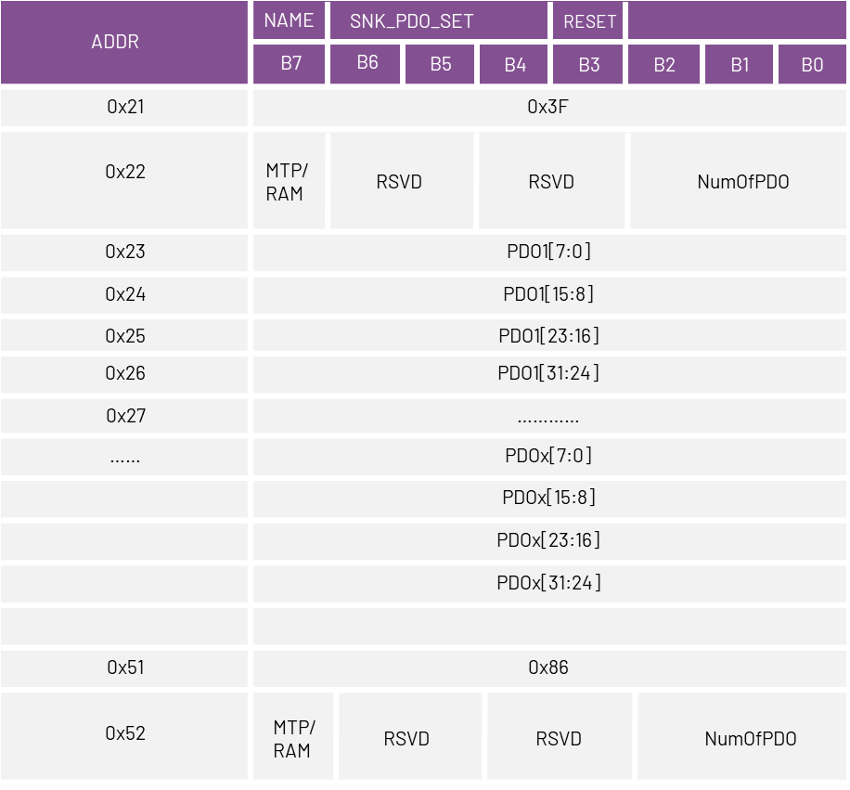
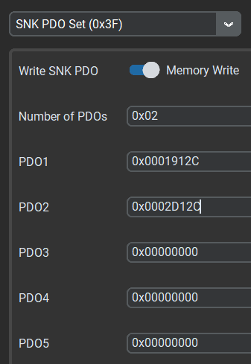
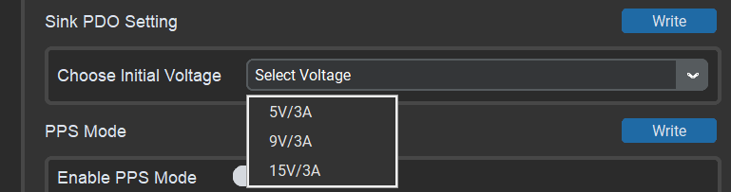
MAX77958 – Setting Initial Plug in Voltage (Sink PDOs)
How do we get these values in the first place?
MAX77958 Memory
RAM /MTP
Command: Set SNK PDOs
5V/3A
5V/3A FPDO
9V/3A FPDO
9V/3A
WRITE
Up to 5 PDOs
MAX77958 (IN SINK SIDE)
Command: SNK_PDO_SET
PROGRAMMER (MAX32660)
Notes:
Now, Lets take the example of using MAX77958 in a mobile phone which requires 9V during PD charging.
MAX77958 has a non-voltage memory named MTP, for Standalone operation,
The user can use a microcontroller or our GUI for programming.
In this case, I have used MAX32660 microcontroller as the programmer
The MAX77958 is capable of taking commands from an external programmer using its Slave I2C port.
The 5V/3A and 9V/3A sink PDOs can be set using the command named SET_SNK_PDO and the command is capable for setting up to 5 sink PDOs inside MAX77958.
As you can see the PDOs take values in binary, we need to have an idea how to convert the voltage and current values to its respective binary values.
For sake of simple demonstration, we have added an option in our GUI to configure the Sink PDOs in its respective voltage and current values
But for understanding purpose lets how we can encode the values in binary.

Slide 14
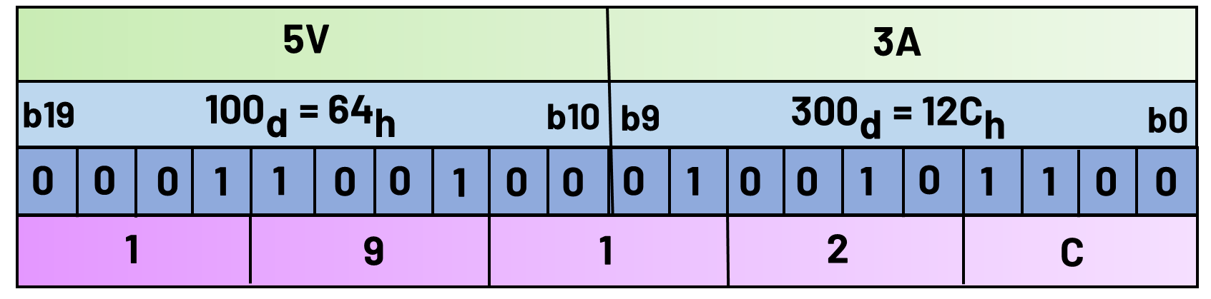
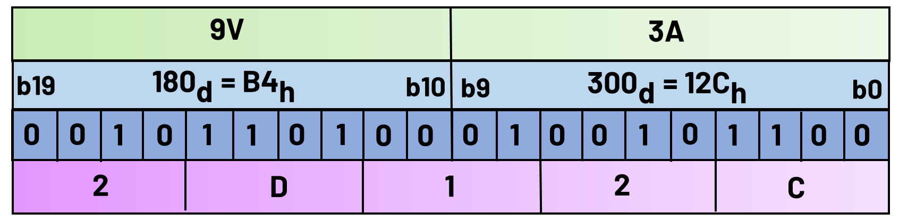

Encoding USB Power Data Objects (PDOs)
Bit(s) | Description
B31…30 | Fixed supply
B29 | Dual-Role Power
B28 | Higher Capability
B27 | Unconstrained Power
B26 | USB Communications Capable
B25 | Dual-Role Data
B24…23 | Fast Role Swap required USB Type C Current 00b: Fast Swap not supported (default) 01b: Default USB Power 10b: 1.5A @ 5V 11b: 3.0A @ 5V
B22…20 | Reserved – Shall be set to zero.
B19…10 | Voltage in 50mV units
B9…0 | Maximum Current in 10mA units
Hex value for 3A = $\frac{\text{Current} \text{Level}}{\text{Current} \text{LSB}}$ = $\frac{\text{3000}\text{mA}}{\text{10}\text{mA}}$ = 300d/12Ch → [B9:B0].
Hex value for 5V = $\frac{\text{Voltage} \text{Level}}{\text{Voltage} \text{LSB}}$ = $\frac{\text{5}\text{000}\text{mV}}{\text{5}\text{0}\text{mV}}$= 100d/64h → [B19:B10].
Combining hex values into a 4-byte format,
Sink PDO1 is configured as 0x0001912C.
PDO 1
PDO 2
Sink PDO2 is configured as 0x0002D12C.
Sink PDO Format (USB Document)
Notes:
This table depicts the format for a sink PDO set based on the USB Standards and this is not available in the datasheet.
I have taken the details from USB PD document available in the USB.org website whose link I have attached with my presentation available in the Hyperion.
Okay, As of now for simplicity, our point of interest is the 20 bitfields from the LSB side and the 2 bitfields from the MSB
The first 10 bitfields corresponds to the current level in 10mA per LSB and the next 10 bitfields corresponds to the voltage level in 50mV LSB.
So, for a fixed 5V/3A PDO, we can divide it with its respective LSB value to get the hex values like mentioned in the slide to get the respective bit values.
Later it can merged for the combined 32 bit value.
Likewise, we can encode 9V/3A to its respective 32-bit format as well.
Now, these values can be used along with the SINK_PDO_SET command to store the voltage levels that the mobile phone supports.

Slide 15
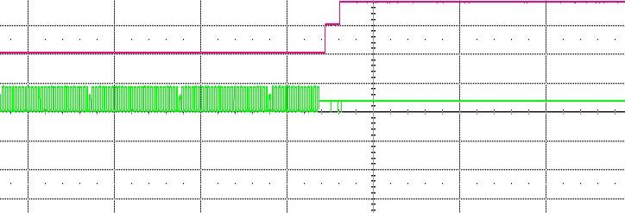
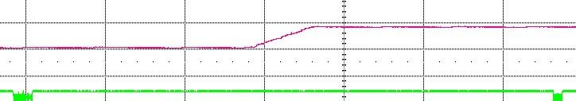

Sink Response to a 60W Samsung adapter
Connection detected
60W PD
9V
5V/3A,
9V,3A,
15V/3A
20V/3A
5V
USB${\text{V}}_{\text{BUS}}$
5V/DIV
Nothing Attached
DRP Mode
MAX77958 in Sink Mode
CC PIN
5V/DIV
Source capabilities
2s/DIV
VBUS
CC2
CC1
MAX77958
PD negotiator
9V
I2C S
5V
I2C M
I2C
MAX77986
Buck Charger
I2C S
Request (from MAX77958)
Answer (from Adapter)
10ms/DIV
Sink side
MAX77958 response to adapter
Notes:
In this slide, I have attached some scope shots to understand the PD messaging through the CC lines for the MAX77958 configured already with the 5Vand 9V sink PDOs
Say for example, if the customer tells you that his adapter is not working with the sink solution that he have with MAX77958.
In such cases, It is always better to scope the cc pins first to understand which side is causing the issue by looking into the messaging.
In this example, lets say we have MAX77958 in the sink side configured for 9V.
Initially MAX77958 is in the DRP mode which you can understand by observing the toggling of the CC pins.
Once the adapter is attached, Standard 5V charging starts, soon followed by adapter sending its source capabilities and the sink requesting for 9V.
Then the adapter accepts and raises the VBUS to 9V and sent the PS READY Power Supply Ready message to the sink.

Slide 16
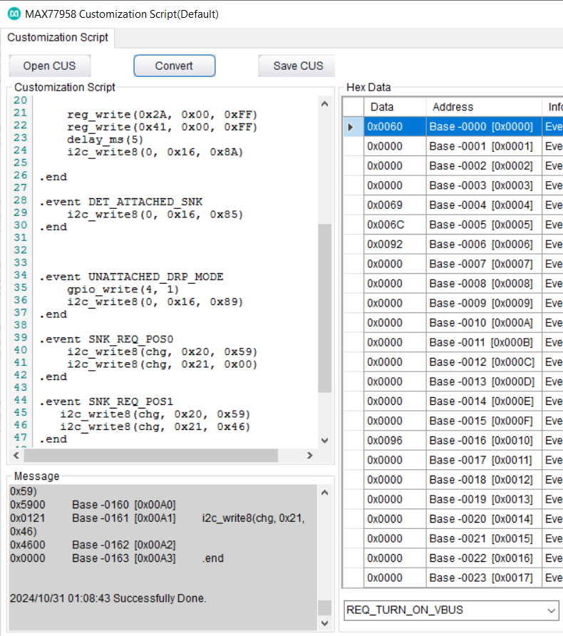
USB PD DRP Solution with MCU
INITIALIZATION
CONNECTION DETECTED
MAX77958’s MTP CONFIGURED USING CUSTOMIZATION SCRIPT AND PROGRAMMED TO MTP BY MCU/GUI
MAX77958 INTERRUPTS THE MCU TO READ CCSTATUS0 REGISTER
USER CAN EITHER USE MAX77958’s MTP OR MCU PROGRAMMING BASED ON PREFERENCE
MCU READS MAX77958 INTERRUPT REGISTERS FOR CLEARING INTERRUPT
USING ONLY MCU PROGRAMMING
CCIStat = NO CONNECTION
CCSTATUS0 [2:0]
CCIStat = SINK (SOURCE DETECTED)
CCIStat = SOURCE(SINK DETECTED)
SOURCE RAISES THE VBUS TO 5V
MAX77958 WRITES MAX77986 REGISTERS CHG_CNFG_11 [6:0] = 0x00 & CHG_CNFG_10 [5:0] = 0x19 FOR OTG OUTPUT OF 5V/3A
MCU READS CC_STATUS0 [5:4] AND CONFIGURES MAX77986 INPUT CURRENT LIMIT
CHARGER DISABLED
Slow Charging
Power Bank (DRP)
MAX77958 WRITES MAX77986 REGISTER CHG_CNFG_00 [3:0] = 0b1010 TO ENABLE OTG MODE
MCU COMMANDS MAX77958 TO
WRITE MAX77986’s
CHG_CNFG_00 [3:0] = 0b0101 TO ENABLE CHARGING MODE
SINK
SOURCE
REVERSE OTG MODE
FORWARD CHARGING
MODE
VBUS
DISABLED
CC1
MAX77958
PD negotiator
MAX77986
Buck Charger
To System
SOURCE SENT ITS CAPABILITIES IN THE FORM OF PDOs
CC2
I2C M
I2C
MAX77958 ADVERISES ITS SOURCE PDOs
I2C S
MAX77958 NEGOTIATES THE HIGHEST POWER PROFILE WITH THE SOURCE, ALIGNING WITH SINK PDOS SET BY THE MCU AT INITIALIZATION.
PD Charging
I2C
MAX32660
MCU
MAX17260/2
Fuel Gauge
SINK SELECTS AND REQUEST FOR A SPECIFIC PDO
I2C
SOURCE ACCEPTS THE REQUEST AND RAISE THE VBUS TO THE REQUESTED PDO VOLTAGE
MAX77958 ACCEPTS THE PDO AND
CONFIGURES THE CHARGER FOR
REQUIRED OTG VOLTAGE AND CURRENT
DYNAMIC VOLTAGE NEGOTIATION
Notes:
But for flexible applications say for example the customer require to change the VBUS dynamically to different voltage levels based on some feedback from sensor then a microcontroller should be used alongside with MAX77958.
This is because the customization script syntax cannot handle such hard tasks.
Lets take the example of a power bank configured in Dual Role Mode.
The flow chart beside depicts on how a MAX32660 microcontroller talks to MAX77958 PD controller for bi-directional charging.
MAX77958 continuously monitor for a connection at the CC pins.
Once a connection is made, the MAX77958 will interrupt the MCU to read the CCSTATUS register which basically tells the type of device connected at the port.
If a sink device like a headset is connected, the MAX77958 takes the role as a source and charges the sink device connected. This can only be done using the customization script configuration
But if the connected device is a source like a PD adapter, the MAX77958 takes the role as sink. The MCU understands this and configure the input current limit of the charger and enables it in the forward charging mode.
Later the MCU reads the source PDOs from MAX77958 RAM and then polls MAX77958 to request for a particular voltage level solely depending on the user requirement at that particular instant and initiates PD charging
Later the MCU can be used for Dynamic Voltage Negotiation.

Slide 17
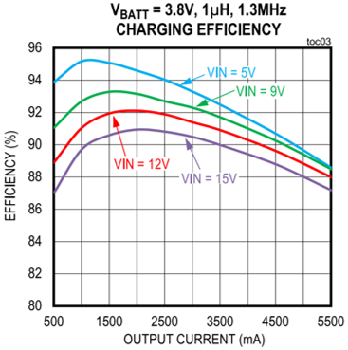
Heating issue at higher power
Sink side
VBUS
5V 9V ……… . 15V
CC1
MAX77958
PD negotiator
MAX77986
Buck Charger
To System
CC2
I2C M
I2C
I2C S
I2C
MAX32660
MCU
MAX17260/2
Fuel Gauge
I2C
Notes:
But if the system requires large power at all the time, then our only option is to keep the VBUS at higher voltage which will lead to heating.
For an application like mobile phone where heat management is critical, this solution will consumer more charging time.
Now we will how direct charging can be used to solve the heating crisis.

Slide 18
Direct/PPS/Fast Charging

Slide 19
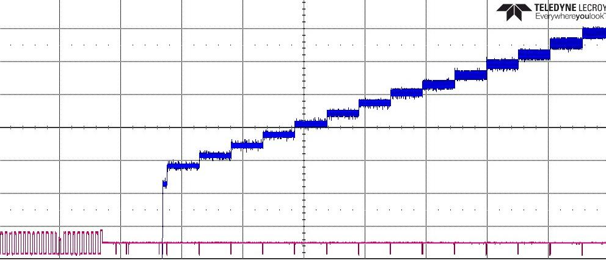
What is Programmable Power Supply (PPS)?
Source
VBUS
Sink
21 V
CC pins
20mV
PPS VOLTAGE
VBUS
50mV/DIV
VBUS
3.3 V
0.5A
50mA
CC PIN
5V/DIV
CC PIN
5 A
PPS CURRENT
MAX77958 PPS negotiation
Notes:
Before moving to Direct charging, we need to understand what PPS or Programmable Power Supply means.
It’s a feature introduced in USB PD 3.0 specifications which allows the user to configure the voltage for a range say 3.3V – 21V in steps of 20mV and current level from 0.5A to 5A in steps of 50mA
As you can see from the scope details attached, there is continuous negotiation between the source and the sink through the CC lines for different voltage level in steps of 20mV
With that kept in mind lets see how PPS feature helps in direct charging.

Slide 20
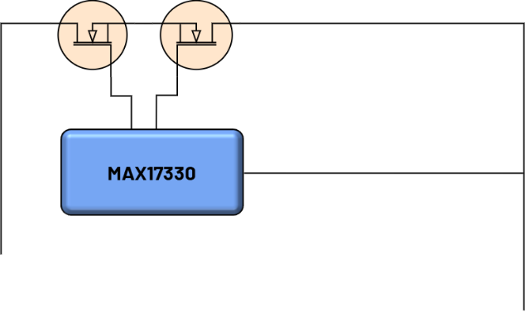

Direct Charging - Solving Heating Crisis
Is there any alternative?
ON
OFF
3A
14V
APDO: 3.3V - 21.0V
VBUS
3.6V
Fuel Gauge +Protector
MAX25432
TCPC
3A
VBUS
CC1
CC1
MAX77958
PD negotiator
MAX77986
Buck Charger
CC2
CC2
I2C M
I2C
CC Comm.
POWER
ALERT
I2C
I2C S
I2C
I2C
MAX32660
TCPM
MAX32660
MCU
3.6V
Source Side (PPS Capable)
Sink side
For a battery voltage of 4.2V, peak charging power for 3A = 12.6 W
Notes:
Let us take an example.
In the source side, let’s say we have the solution with MAX25432B which is capable of delivery APDO (PPS PDO) in the range of 3.3V – 21V and the sink consists of of an additional MAX17330
Fuel gauge + charger.
In the sink side we have added MAX17330 is configured in load switch mode and initially the switch will be disabled.
1) Once the connection is made between the source and the sink, the VBUS will raise to 5V.
2) Then MCU reads the batt voltage and current. Considering a battery voltage of 3.6V, the MCU polls MAX77958 to request the source to raise the VBUS to 3.6V.
3) Once the VBUS is 3.6V, the load switch is safe to close.
4) The microcontroller keep on polling the MAX77958 to raise the VBUS in small steps until the charging current meets the set current.
But the issue with this setup is the charging current is limited by the cable current say 3A. So it can only provide power of 12.6W considering a battery voltage of 4.2V.
Now our only option is to use a converter in between and raise the VBUS levels keeping the current under limit.

Slide 21



Switched Capacitor Converter (SCC) for higher power
$${\text{C}}_{\text{FLY}}$$
$${\text{C}}_{\text{HIGH}}$$
$${\text{C}}_{\text{LOW}}$$
APDO: 3.3V - 21.0V
ON
LTC7825
(S.C.C.)
OFF
2:1
VBUS
7.2V
RUN
6A
MAX25432
TCPC
VBUS
CC1
CC1
MAX77958
PD negotiator
MAX77986
Buck Charger
CC2
CC2
I2C M
I2C
CC Comm.
POWER
ALERT
I2C
I2C S
I2C
3.6V
MAX32660
TCPM
MAX32660
MCU
MAX17260/2
Fuel Gauge
I2C
Source Side
Sink side
For a battery voltage of 4.2V, peak charging power for 6A = 25.2 W
Notes:
So, we can use a 2:1 switched capacitor.
Now, even though the VBUS is double the battery voltage and if we enable the converter no current will flow.
1) Like Before, the MCU will read the voltage of the battery and polls MAX77958 to request the source to raise the VBUS to double the battery voltage.
2) Now, the MCU enables the SCC and polls MAX77958 continuously to request the source to raise the VBUS till the charging current reaches the set current, say 6A in this case.
Like wise the user can use a 3:1 SCC or higher based on the charging requirement.
The SCC is highly efficient compared to a normal buck charger.

Slide 22
USB PPS FAST CHARGING S/M
CONNECTION DETECTED
MAX77958 INTERRUPTS THE MCU TO READ CCSTATUS0 REGISTER
USER CAN EITHER USE MAX77958’s MTP OR MCU PROGRAMMING BASED ON PREFERENCE
USING ONLY MCU PROGRAMMING
MAX77958’s MTP CONFIGURED USING CUSTOMIZATION SCRIPT AND PROGRAMMED TO MTP BY MCU/GUI
MCU READS MAX77958 INTERRUPT REGISTERS FOR CLEARING INTERRUPT
CCIStat = NO CONNECTION
MCU READ CCSTATUS0 [2:0]
CCIStat = SINK (SOURCE DETECTED)
MCU READS THE BATT VOLTAGE AND CURRENT
CCIStat = SOURCE (SINK DETECTED)
SOURCE RAISES THE VBUS TO 5V
MAX77958 WRITES MAX77986 REGISTERS CHG_CNFG_11 [6:0] = 0x00 & CHG_CNFG_10 [5:0] = 0x19 FOR OTG OUTPUT OF 5V/3A
MCU REQUESTS MAX77958 TO PULL VBUS TO VBATT AND ENABLE SCC
CHARGER DISABLED
MCU READS CC_STATUS0 [5:4] AND CONFIGURES MAX77986 INPUT CURRENT LIMIT
Slow Charging
MAX77958 WRITES MAX77986 REGISTER CHG_CNFG_00 [3:0] = 0b1010 TO ENABLE OTG MODE
MCU COMMANDS MAX77958 TO
WRITE MAX77986’s
CHG_CNFG_00 [3:0] = 0b0101 TO ENABLE CHARGING MODE
IF VBATT <
VPRECHG
NO
IF VBATT <
VTRKLE
NO
IF VBATT <
VTERM
NO
IF VBATT =
VTERM
YES
YES
YES
YES
SOURCE SENT ITS CAPABILITIES IN THE FORM OF PDOs
PRECHARGING
TRICKLE CHARGING
FAST CHARGING
CV CHARGING
MAX77958 ADVERISES ITS SOURCE PDOs
CC CV CHARGING STATE MACHINE
MCU CHECKS AND SORTS OUT THE AVAILABLE APDOs
SINK SELECTS AND REQUEST FOR A SPECIFIC PDO
AVAILABLE APDOs?
NO
PD CHARGING
CHARGING DONE
MAX77958 ACCEPTS THE PDO AND
CONFIGURES THE CHARGER FOR
REQUIRED OTG VOLTAGE AND CURRENT
YES
MCU INSTRUCTS MAX77958 TO ENABLE PPS MODE
Notes:
As we know switched capacitor converter is a converter and not a charger, the charging state machine is implemented inside the microcontroller for fast charging.
1) Like before the operation is same till the slow charging.
2) But now once the source has sent its capabilities, the MCU checks for any available APDOs.
3) If no APDOs are available, the MCU will initiate for PD charging like as before.
4) If an APDO is available, the MCU enables the PPS mode in MAX77958 then reads then battery voltage and current.
5) Based on the battery voltage level, the different charging profile is implement.
6) In that when the battery voltage is above trickle and below termination voltage, then it is CC charging which in other words called Fast Charging.
Now lets compare the efficiency between the two types of charging namely PD and PPS charging.

Slide 23
Efficiency Analysis

Slide 24
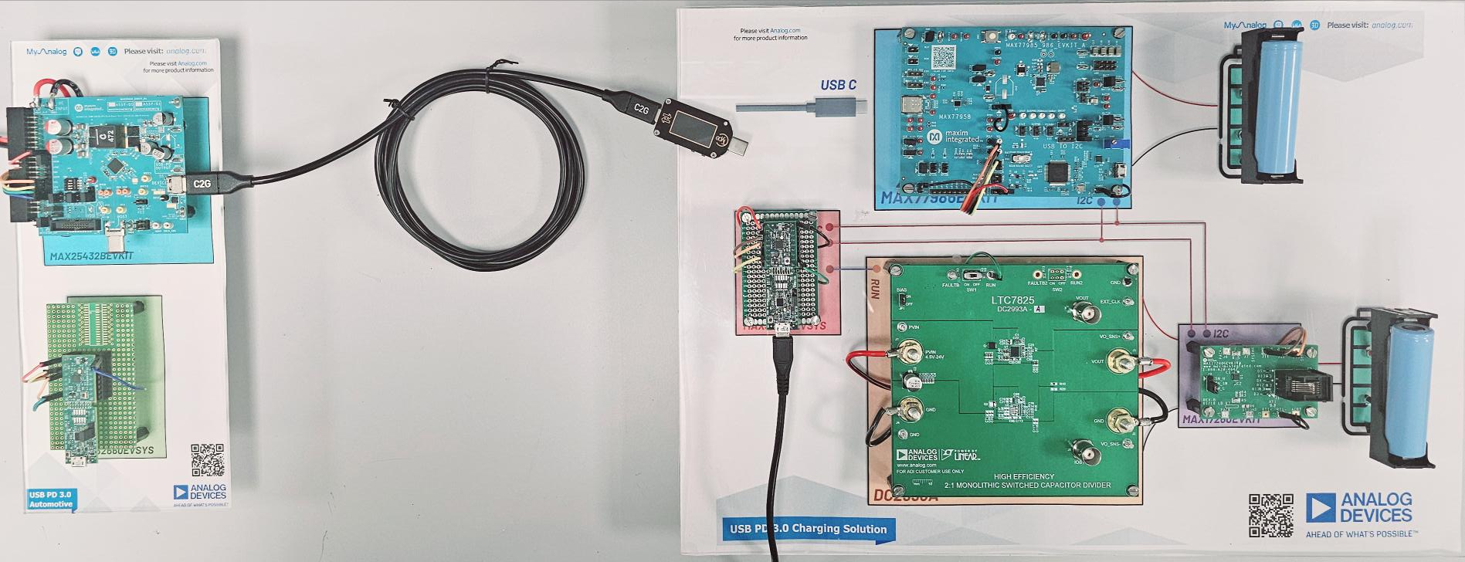
Experiment Setup
14V
PD CHARGING
SINK SIDE
To PC
FAST CHARGING (PPS)
SOURCE SIDE (FAST CHARGING CAPABLE)
SINK SIDE (FAST CHARGING CAPABLE)
Notes:
Let me briefly explain the experiment setup.
In the source side, I have used MAX25432BEVKIT along with the MAX32660EVKIT. This is powered by 14V voltage source mimicking a car battery.
In the sink side, MAX77986EVKIT is used for PD charging.
For Fast charging MAX32660EVKIT along with DC2993A consisting of our SCC IC is used along with a single cell fuel gauge MAX17260EVKIT to monitor the battery.
Instead of a single cell, I have used two cells for doing comparison at the same time.

Slide 25
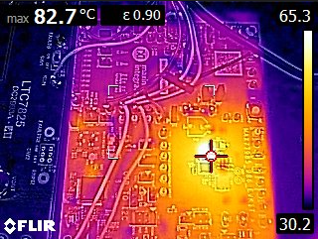
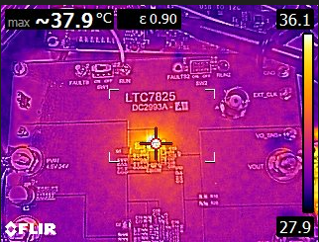
IC Thermal comparison at 5.5A charging current
USB PD Charging
USB PPS CHARGING
Notes:
We can see a significant heating difference between the buck charger and a switched capacitor converter for a given charging current of 5.5A
The MAX77986 is heating up to 82.7 degree.

Slide 26
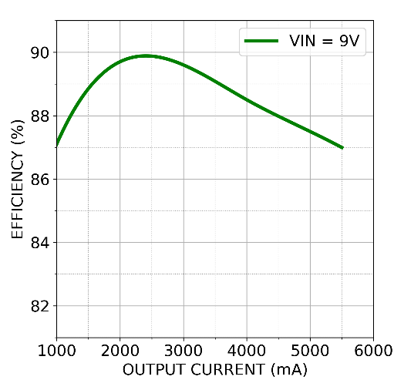
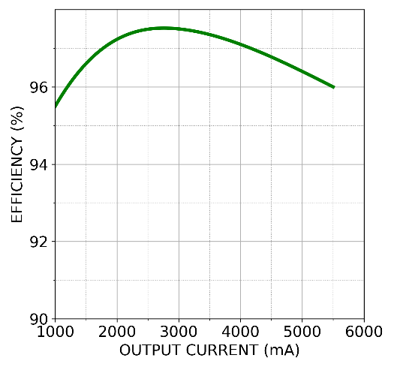
Efficiency Results
USB PD Charging
USB PPS CHARGING
USB VOLTAGE (V) | USB CURRENT (A) | OUTPUT VOLTAGE (V) | OUTPUT CURRENT (A) | EFFICIENCY (%)
9.1968 | 0.4864 | 3.896 | 1 | 87.1
9.1686 | 0.9757 | 4.013 | 2 | 89.7
9.1300 | 1.5149 | 4.133 | 3 | 89.6
9.0877 | 2.1121 | 4.259 | 4 | 88.5
9.0406 | 2.7639 | 4.375 | 5 | 87.5
9.0173 | 3.1176 | 4.436 | 5.5 | 86.8
USB VOLTAGE (V) | USB CURRENT (A) | OUTPUT VOLTAGE (V) | OUTPUT CURRENT (A) | EFFICIENCY (%)
7.89 | 0.566 | 3.915 | 1.09 | 95.5
8.18 | 1.012 | 4.026 | 2 | 97.25
8.44 | 1.51 | 4.141 | 3 | 97.5
8.78 | 1.96 | 4.282 | 3.9 | 97.07
9.23 | 2.515 | 4.478 | 5 | 96.45
9.58 | 2.98 | 4.624 | 5.92 | 96.01
89.9
97.5
Notes:
In the analysis, efficiency has been taken for output current from 1 -5.5A in steps of 1A
The maximum efficiency the buck was able to attain was only 89.9% unlike LTC7825 which went up to a very high level staying at 97.5%
From this experiment we can clearly see that PPS/Fast/Direct Charging is necessary to keep the charging time low with better heat management.

Slide 27
How to find Opportunities?
Ask the question:
What is the power requirement?
Battery Specs
> 15W
Charging current
Heat Sensitive Application?
Smart Phones
Tablets
Yes
Gaming laptops
Power Banks
VR Headset
No
Gaming controllers
Programmable Power Supply
Power Delivery
Demonstration
Support: APIs, Reviews….
Notes:
Choosing charger based on cell configuration
Asking the application type? Adding PPS in addition to PD for fast charging with less heating

Slide 28
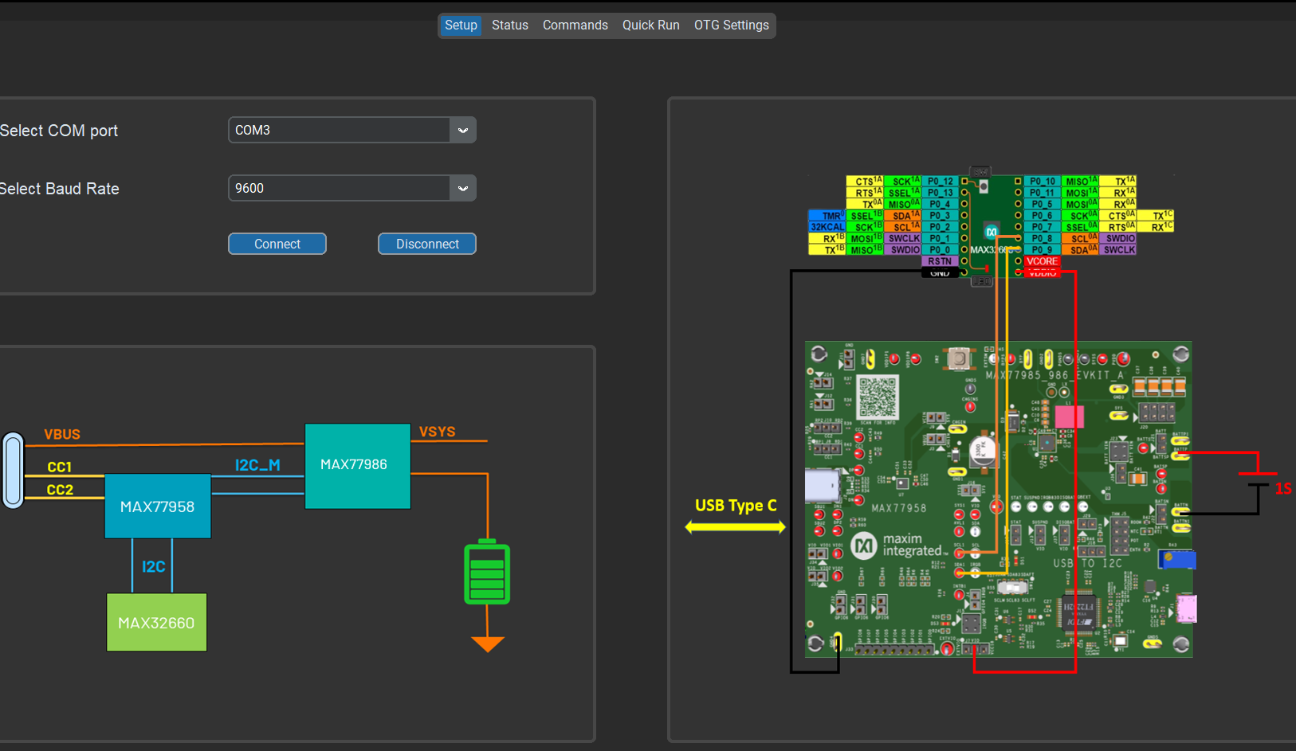
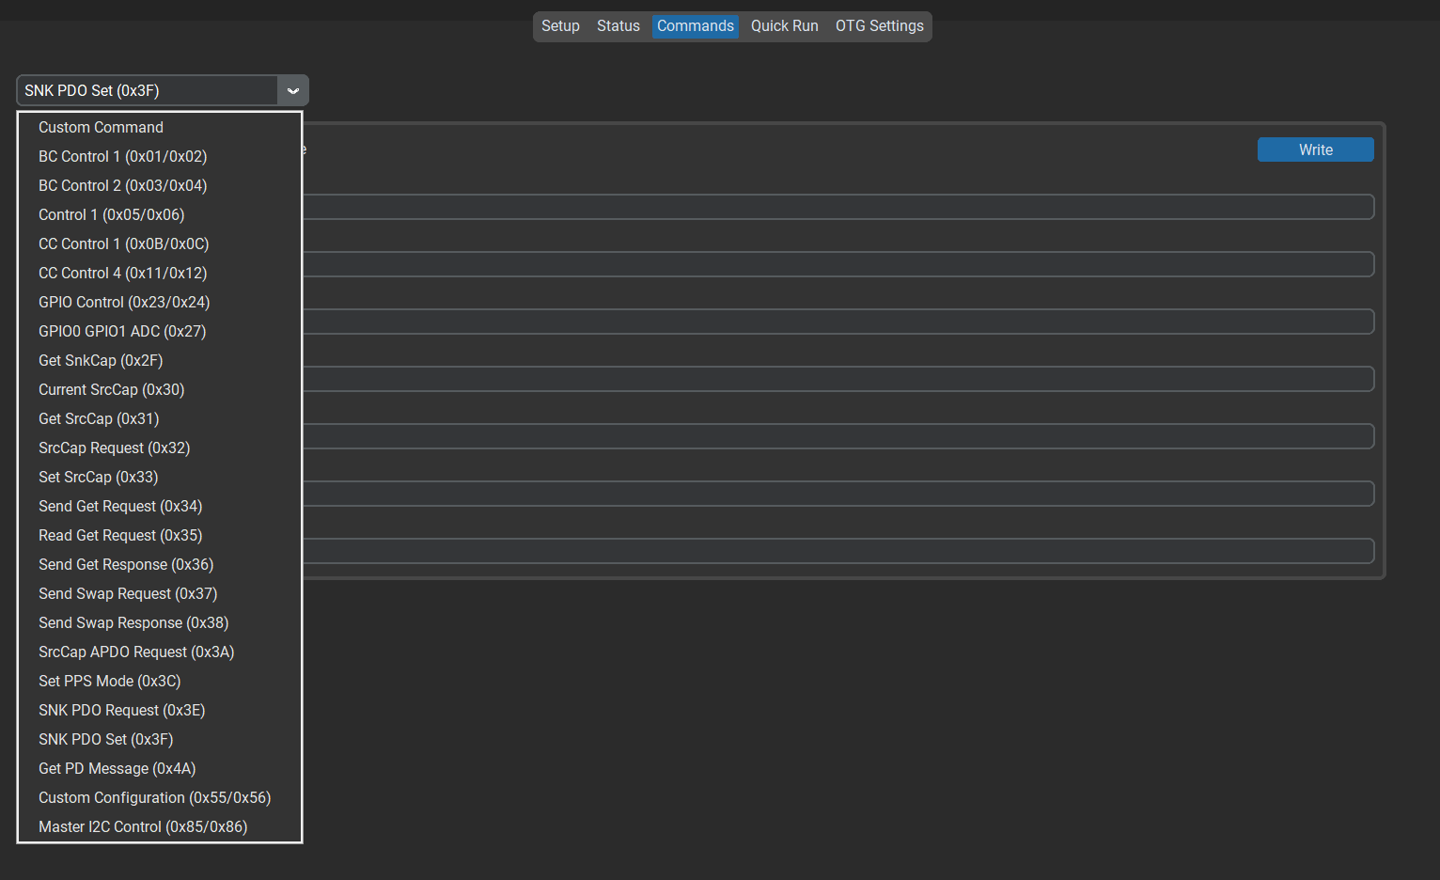
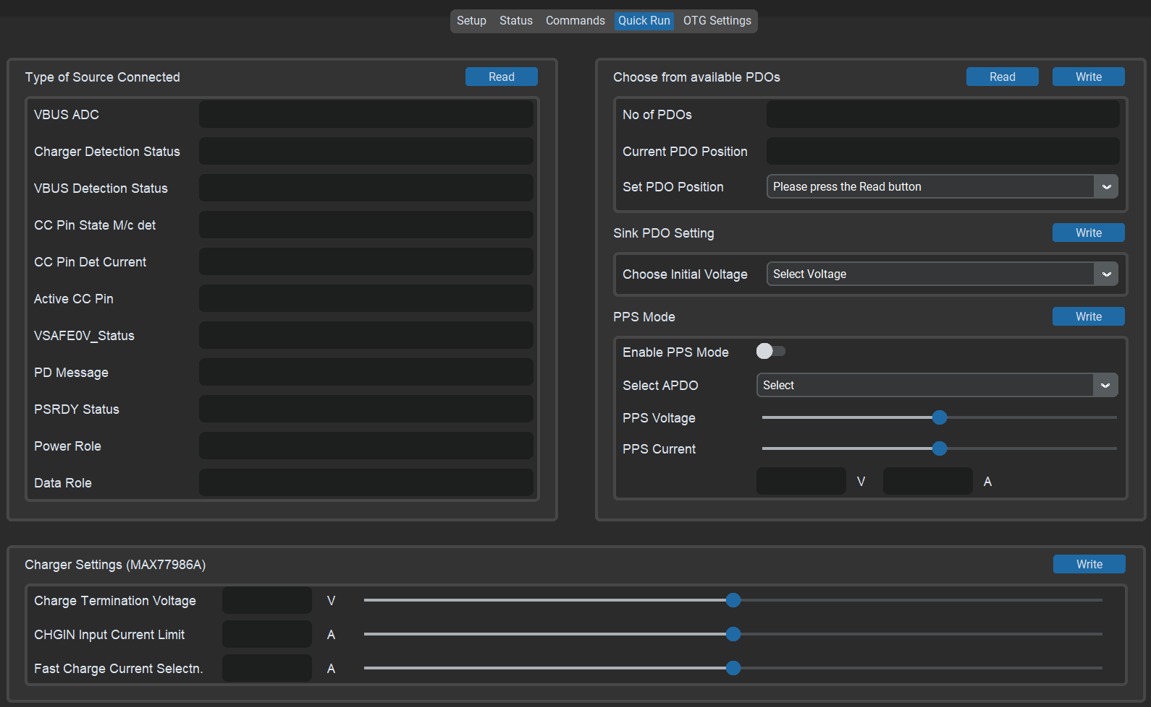
Product Support
Demonstration Support:
Python GUI and Driver Support based on MAX32660
System Level APIs and Libraries:
MAX77958, MAX77985/85, MAX77960/61/62,
MAX17260/1/2
Technical Issue Debugging
Contact Persons:
Fahad Ahammad (Ahammad.Fahad@analog.com)
Sai Kumar (Saikumar.Kummari@analog.com)

Slide 29
Questions?

Slide 30



Thank You!
Please Remember to Rate this Session in the Mobile App!

